Slide 1
Utah Stimulating Access to Research in Residency
NIH/NHLBI Award 1R38HL167282-01

Slide 2
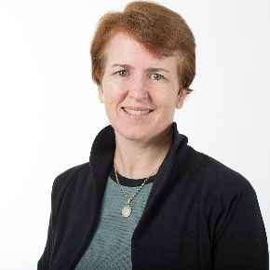
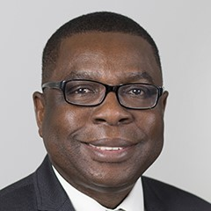
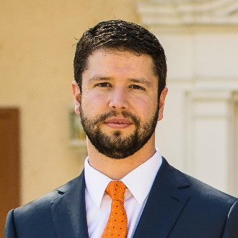
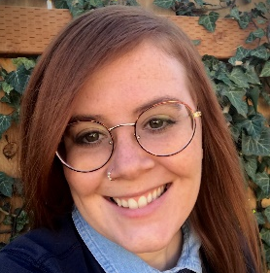
: Team
Utah StARR Program Directors
Molly Conroy MD, MPH
Professor and Division Chief
General Internal Medicine
Kola Okuyemi MD, MPH
Professor and Chair
Department of Family and Preventive Medicine
Evaluations
Administration
Trent Matheson MPP
Center for Clinical and Translational Science
Quinn Tanner MSPH
Family & Preventive Medicine, University of Utah

Slide 3
: Overview
Utah StARR Program Goals
To increase the number of resident investigators aimed at reducing health disparities impacting disadvantaged populations
To apply continuous learning that ensures success and facilitates
high-quality clinical and translational research training
To prepare resident investigators to successfully transition to funded physician investigator careers in their chosen specialty
Utah StARR is designed to prepare outstanding residents for a career in academic medicine and clinical investigation – and to provide an early “on-ramp” to research careers for competitive academic faculty positions.

Slide 4
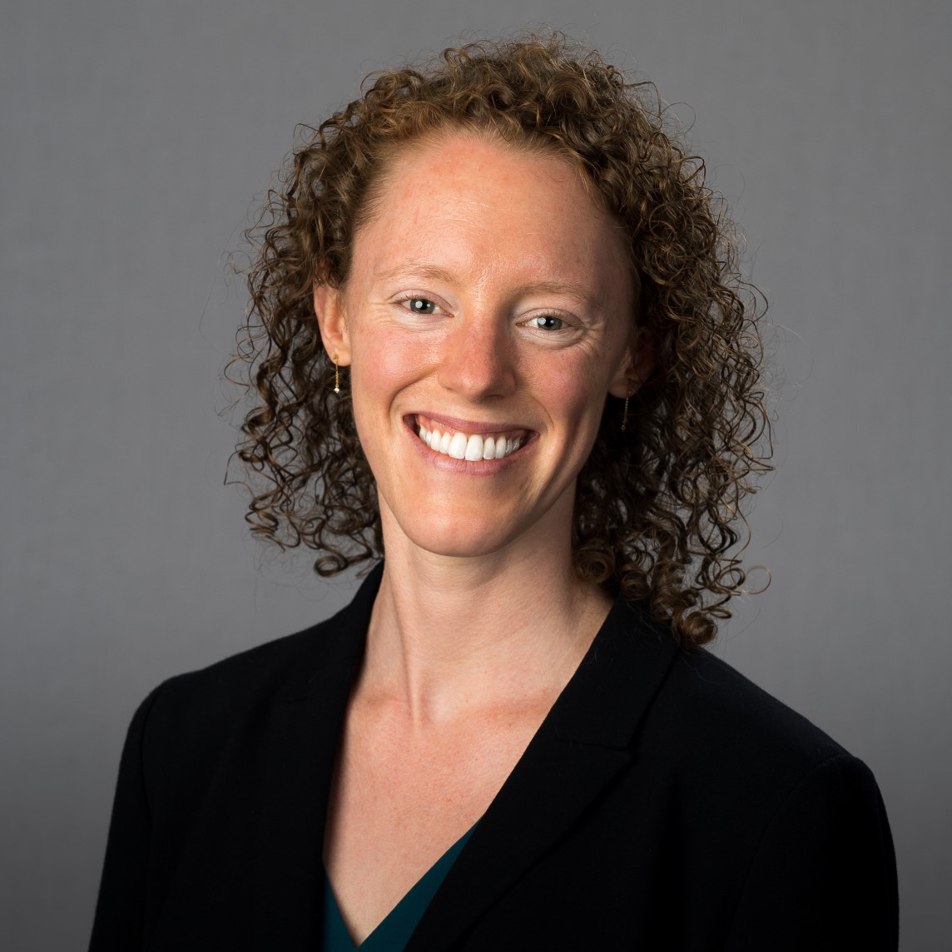
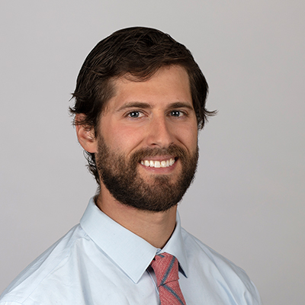
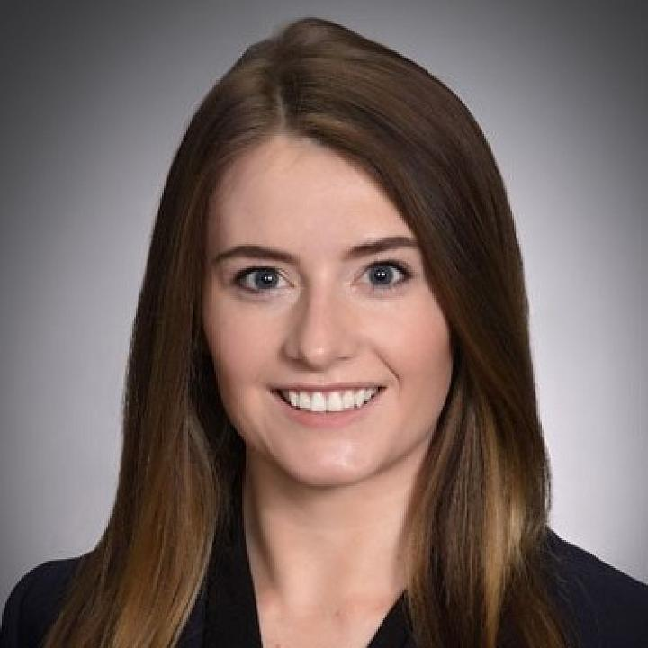
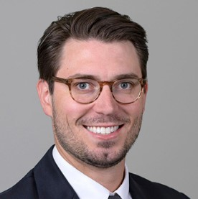
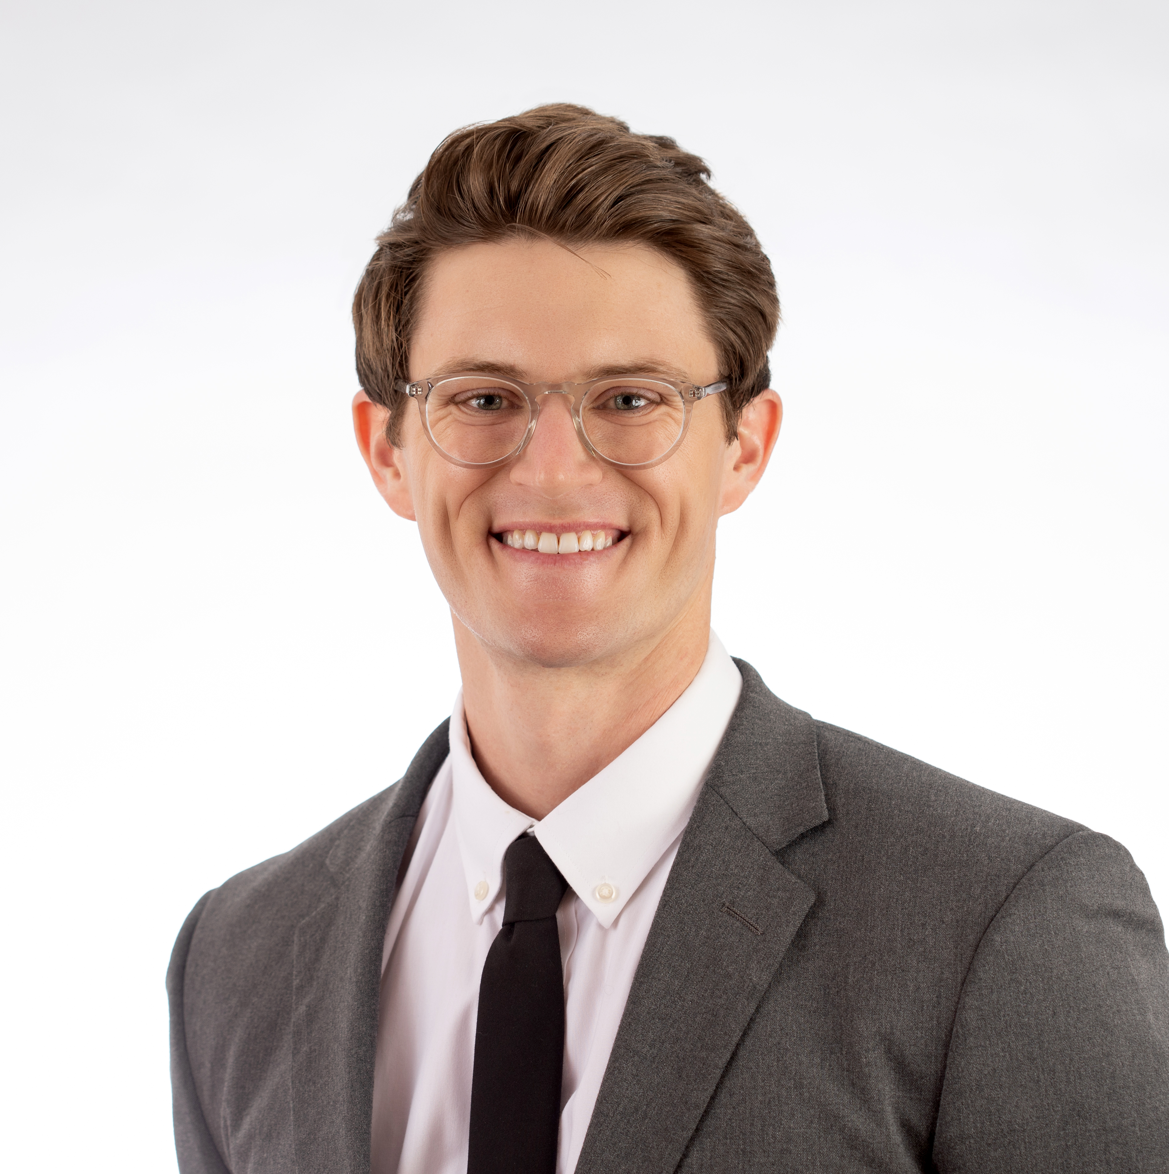
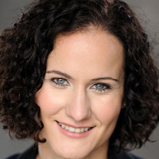
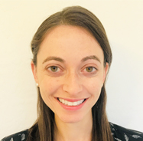
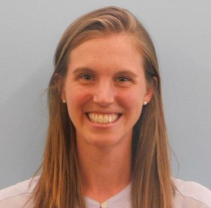
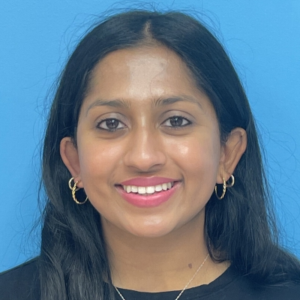
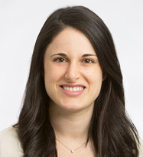
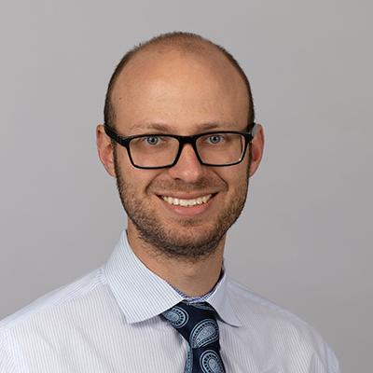
: overview
7 Participating University of Utah Residency Programs & 11 UStARR Scholars
Family Medicine: Research Track | Kayla Jordanova PGY3
Internal Medicine | Alex Zheutlin Graduated | Victoria Vardell Graduated | RJ Williams PGY4 | Boomer Olsen PGY2
Pediatrics | Kathleen Campbell Graduated | Amara Finch PGY3 | Anna Jones PGY3 | Meera Nagarajan PGY2
Combined Medicine-Pediatrics | TBTTBTBDD
Obstetrics & Gynecology | Lauren Gimbel Graduated
Neurology | Eric Stulberg PGY5
Occupational Medicine | TBD

Slide 5
Family Medicine Research Track
Utah StARR provides a unique opportunity to Family Medicine residents in the form of a dedicated research track
Utah StARR is one of the few programs that offers Family Medicine residents the opportunity to join a dedicated research track during their residency
This dedicated time, along with the support of mentor teams and training opportunities, supports scholars in their long-term academic medicine career
Utah StARR scholars have access to a multitude of training opportunities that can be individualized to each resident's personal needs and goals
Family Medicine UStARR Scholar:
Kayla Jordanova (Hatchell)
“The StARR program is one of only a few programs in the country where residents have dedicated time for research training, especially in family medicine, so it was a great fit!”

Slide 6
Family Medicine and Utah StARR Schedule
Sample Schedule 1 (Kayla’s Schedule) | July – September | October – December | January – March | April - June
PGY-1 | Clinical Rotations | Clinical Rotations | Clinical Rotations | Clinical Rotations
PGY-2 | Research Block 1 | Clinical Rotations | Clinical Rotations | Clinical Rotations
PGY-3 | Research Block 2 | Clinical Rotations | Clinical Rotations | Clinical Rotations
PGY-4 | Research Block 3 |  | Clinical Rotations | Clinical Rotations
Sample Schedule 2 | July – September | October – December | January – March | April - June
PGY-1 | Clinical Rotations | Clinical Rotations | Clinical Rotations | Clinical Rotations
PGY-2 | Clinical Rotations | Research Block 1 | Clinical Rotations | Clinical Rotations
PGY-3 | Clinical Rotations | Clinical Rotations | Clinical Rotations | Clinical Rotations
PGY-4 | Clinical Rotations | Research Block 2 | Clinical Rotations | Clinical Rotations
Sample Schedule 3 | July – September | October – December | January – March | April - June
PGY-1 | Clinical Rotations | Clinical Rotations | Clinical Rotations | Clinical Rotations
PGY-2 | Clinical Rotations | Clinical Rotations | Clinical Rotations | Research Block 1
PGY-3 | Research Block 1 (continued) |  | Clinical Rotations | Clinical Rotations
PGY-4 | Clinical Rotations | Clinical Rotations | Clinical Rotations | Research Block 2
Utah StARR allows residents 12-24 months of dedicated research time to prepare for a long-term career in academic medicine. Schedules are individualized based on prior research experience and scheduling needs – see two sample schedules above

Slide 7
Current Experience
Utah StARR provides a unique opportunity to Family Medicine residents in the form of a dedicated research track
The purpose of MAINTAIN Prime is to study if primary care staff acting as health coaches through MyChart can help patients maintain their previous intentional weight loss over 2 years.
Courses in the Master of Science in Clinical Investigation help to strengthen research skills.
Seminars and journal club series build a community amongst residents and faculty.
“The StARR program has given me the community and experiences I was looking for, and I would love to talk with any of you who are interested in hearing more or applying."

Slide 8
: Offerings
Additional 12 months of dedicated research time during residency allows scholars to access:
Evidence-based training utilizing the Matrix Model of Mentoring
Access to and support from nearly 50 expert research mentors at the University of Utah Hospitals
Financial support for research-associated costs and travel
1:1 monthly career mentoring meetings with Program Directors utilizing individual development plan
Additional training via non-degree coursework from the Master of Science in Clinical Investigation (MSCI)
Eligibility to apply for the NIH Loan Forgiveness Program
Bimonthly expert-led seminar series to discuss career trajectories, networking, work-life integration, and other topics
Bimonthly scholar-led research seminars to discuss noteworthy publications and research strategies
Grant writing classes and support, including pre-submission grant review, pre-award support, and writing workshops
Opportunity to get continued research support from the NIH via the K38 “Stimulating Access to Research in Residency Transition Scholar” (StARRTS) program

Slide 9
: Outcomes
Graduated and Current Scholars…
Have 77 publications, including:
27 first-author publications
Are co-Is on grants, including:
HCI Pilot Project Award
T32 Fellowship
Have 57 Posters, Presentations, & Abstracts, including:
American Society of Hematology abstracts and presentations
Highlighted presentations at the University of Utah’s Internal Medicine Grand Rounds
Graduates been accepted to their top choices for post-UStARR positions, including:
Coveted University of Utah and Huntsman Cancer Institute positions
Cardiology fellowship at Northwestern University
Developmental and Behavioral Pediatrics fellowship at the Children’s Hospital of Philadelphia

Slide 10
For additional information:
Visit the UStARR website: https://medicine.utah.edu/utah-starr
Email program administrators: utahstarr@utah.edu

